Slide 1
Title
Information provided by:
What You Should Know
About COPD
For content review only. Template and graphics to be updated; references to be finalized upon content approval.

Slide 2
Quick Facts
Quick Facts
COPD stands for chronic obstructive pulmonary disease.
4th leading cause of death in the U.S., accounting for nearly 155,000 deaths per year.¹
16 million people have been diagnosed with COPD and it is estimated that millions more have it but do not know it.²
A leading cause of disability³ and an estimated 1 in 5 adults, age 45 and over, suffers from COPD.⁴
2
Notes:
¹ Heron M. (2018). Deaths: Leading causes for 2016. National Vital Statistics Reports; vol 67 no 6. Hyattsville, MD: National Center for Health Statistics.
² Ford, E. S., Croft, J. B., Mannino, D. M., Wheaton, A. G., Zhang, X., & Giles, W. H. (2013). COPD surveillance—United States, 1999-2011. Chest, 144(1), 284-305.
³ MW Brault, J Hootman, CG Helmick, KA Theis, and BS Armour., “Prevalence and most common causes of disability among adults — United States, 2005,” Morbidity and Mortality Weekly Report (MMWR), 58 (16), pp. 421-426 (May 1, 2009), Centers for Disease Control and Prevention (CDC)
⁴ Age-adjusted Prevalence of COPD among adults aged ≥18 years – BRFSS, United States, 2015

Slide 3
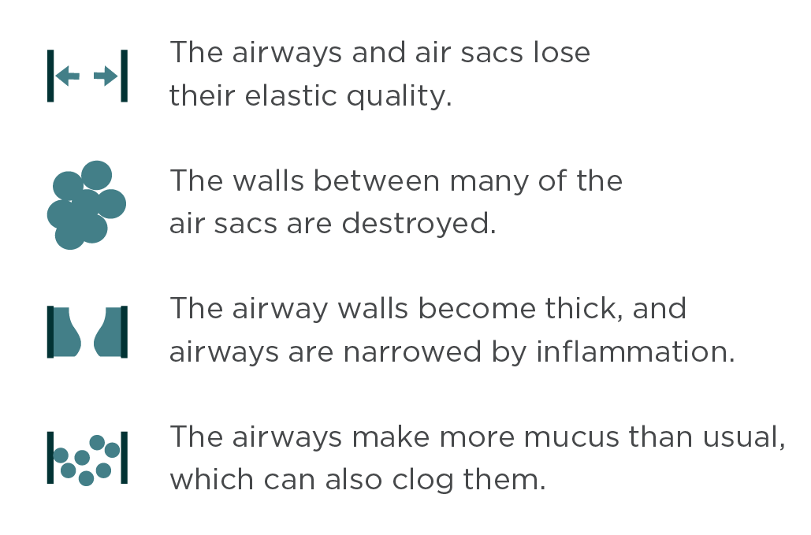
What is COPD
What is COPD?
COPD is a serious lung disease that over time makes it hard to breathe.
Less air flows in and out of the airways because of one or more of the following:
Left untreated, people with COPD gradually lose their stamina and ability to perform daily activities.
3

Slide 4
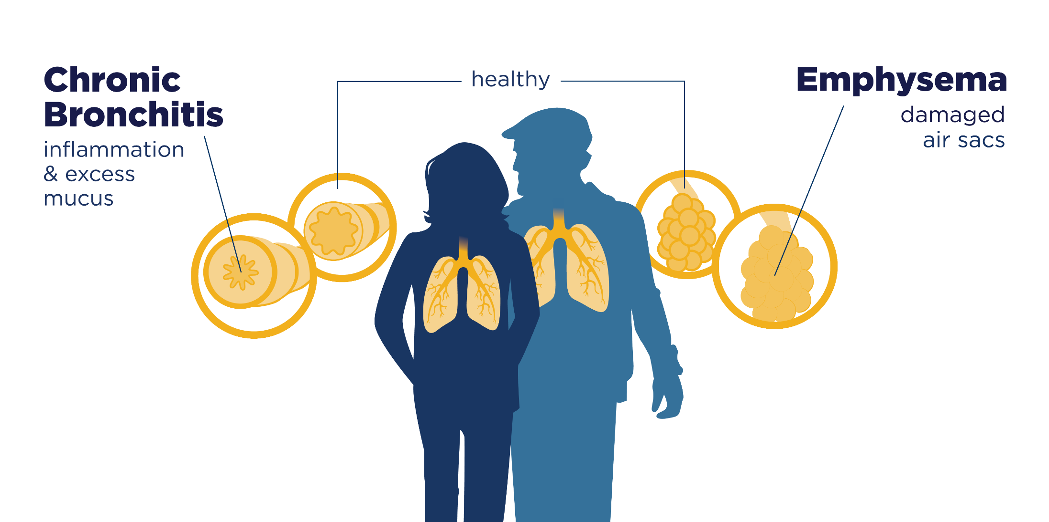
COPD Includes Two Main Conditions
COPD Includes Two Main Conditions
4

Slide 5
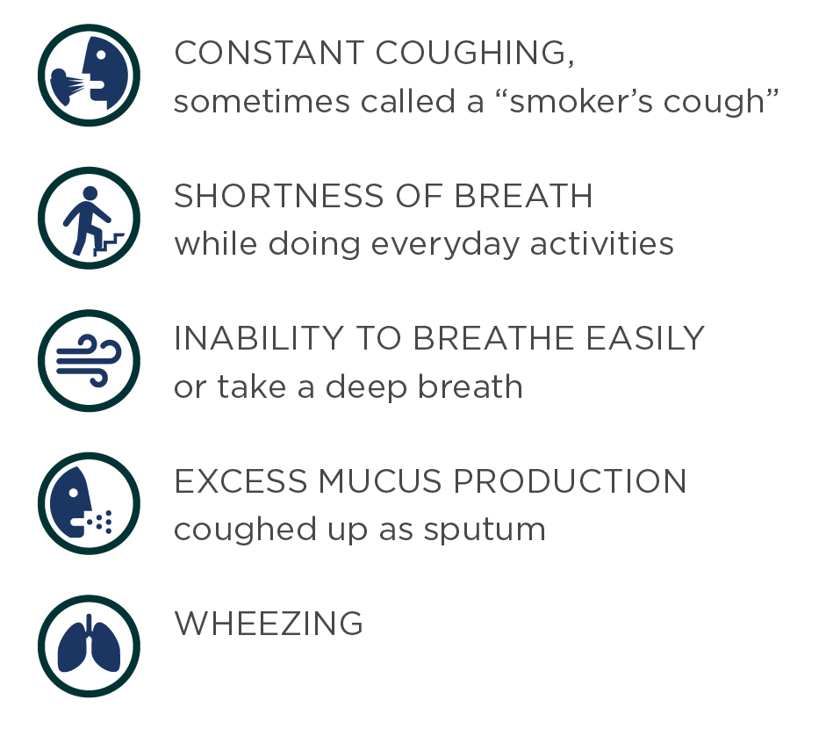
Common signs and symptoms
Common
Signs & Symptoms
include…
5

Slide 6
Causes & Risk Factors
Smoking is responsible for roughly 8 out of 10 COPD deaths and it is the number one cause of COPD: 75% of COPD cases occur in people who have a history of smoking.⁵
Roughly one-half of these cases are current smokers (38%), and one-half are former smokers (37%).⁶
However, as many as 1 out of 4 people (25%) who have COPD have never smoked.⁷
SMOKING

Slide 7
Causes and risk factors 1
Causes & Risk Factors
LONG-TERM EXPOSURE TO LUNG IRRITANTS
Long-term exposure to second-hand smoke and other lung irritants such as certain chemicals, dusts, or fumes from the environment or workplace can also increase risk for COPD.
GENETIC CONDITION
As many as 100,000 Americans have alpha-1 antitrypsin, or AAT, deficiency. They can get COPD even if they have never smoked or had long-term exposure to harmful pollutants.⁸
7
Notes:
⁸ Wheaton, A. G., Cunningham, T. J., Ford, E. S., & Croft, J. B. (2015). Employment and activity limitations among adults with chronic obstructive pulmonary disease—United States, 2013. MMWR. Morbidity and mortality weekly report, 64(11), 289.
⁹ Centers for Disease Control and Prevention. (2010). How tobacco smoke causes disease: The biology and behavioral basis for smoking-attributable disease: A report of the surgeon general.

Slide 8
Who is at higher risk for COPD
Who is at higher risk for COPD?
While COPD affects all Americans, some are more at risk than others:
Men vs. Women:
Women are 30% more likely to report having COPD than men.²
Geographic Distribution:
Prevalence of COPD in rural areas (8.2%) is almost twice as high compared to urban areas (4.7%).⁹
Higher prevalence in the Southeast and areas of the Mississippi and Ohio River Valleys.²
Racial/Ethnic Groups:
More than 1 in 10 American Indian/Alaska Natives have been diagnosed with COPD – a higher proportion than most other racial/ethnic group in the U.S.²
11%
10%
6%
6%
3%
Who has COPD?
Hispanics
American Indians/
Alaska Natives
Multiracial
Whites
Non-Hispanic
Blacks
8
Notes:
² Ford, E. S., Croft, J. B., Mannino, D. M., Wheaton, A. G., Zhang, X., & Giles, W. H. (2013). COPD surveillance—United States, 1999-2011. Chest, 144(1), 284-305.
⁵ Croft JB, Wheaton AG, Liu Y, et al. Urban-rural and state differences in COPD prevalence, Medicare hospitalizations, and mortality — United States, 2015. MMWR Morb Mortal Wkly Rep. 2018;67(7):205–211. https://www.cdc.gov/mmwr/volumes/67/wr/mm6707a1.htm?s_cid=mm6707a1_w/

Slide 9
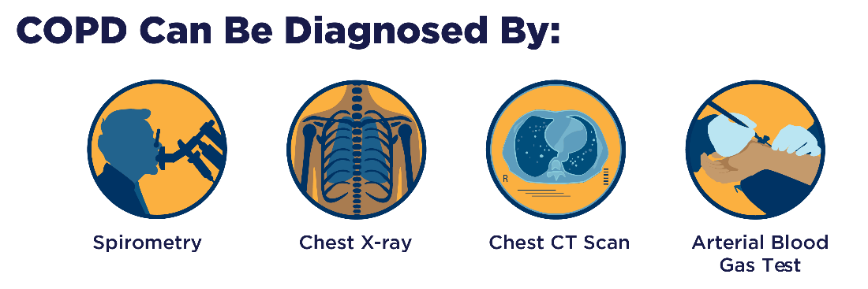
Diagnosing COPD
Diagnosing COPD
COPD diagnosis is based on signs and symptoms, personal and medical history in addition to physical examinations and lung function tests, such as spirometry.
It is estimated that millions do not realize they have COPD and are undiagnosed:
Physicians report that one of the biggest barriers to COPD diagnosis is that patients do not fully report their symptoms or smoking history.¹⁰
9
Notes:
¹⁰ National Heart, Lung, and Blood Institute. (2018). COPD: Tracking Perceptions of the Individuals Affected and the Providers Who Treat Them.

Slide 10
Treatment of COPD
Treatment of COPD
While currently there is no cure for COPD, the disease is highly treatable and manageable.
Treatment may include:
Medicine
Pulmonary rehabilitation
Lifestyle changes
10

Slide 11
Pulmonary Rehabilitation
Pulmonary Rehabilitation
Pulmonary rehabilitation may help people with chronic breathing problems to live and breathe better.
2 in 3 people who participate in pulmonary rehabilitation report positive outcomes.¹¹
Pulmonary Rehabilitation
can help to:
11

Slide 12
Awareness of COPD
Awareness of COPD
Awareness of COPD has increased in the past 10 years, yet nearly one-quarter of adults in the U.S. have not heard of COPD.¹⁰
Roughly 3 out of 10 people with COPD symptoms go undiagnosed and untreated.¹⁰
In 2018, 7 out of 10 people who were symptomatic of COPD reported those to their health care providers.
12
Notes:
¹⁰ National Heart, Lung, and Blood Institute. (2018). COPD: Tracking Perceptions of the Individuals Affected and the Providers Who Treat Them.

Slide 13
Advancing Knowledge
Advancing Knowledge
Overcoming barriers to prevention, early diagnosis, treatment, and management of COPD can help slow the progression of the disease and lessen some symptoms.
Of those who have COPD or know someone who does, 50% are interested in getting more information about COPD treatment.¹⁰
Of particular interest is information about availability/effectiveness of treatments, effectiveness of new treatments, and ongoing research advancing treatments.
13
Notes:
¹⁰ National Heart, Lung, and Blood Institute. (2018). COPD: Tracking Perceptions of the Individuals Affected and the Providers Who Treat Them.

Slide 14
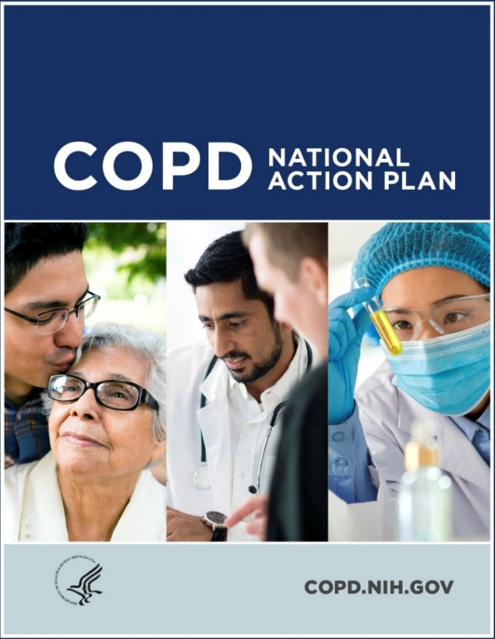
COPD National Action Plan
COPD National Action Plan
Millions have already been spent on direct, and indirect, costs for COPD-related care and it is expected to increase.
Developed at the request of Congress with input from the broad COPD community.
The first-ever blueprint for a multi-faceted, unified fight against the disease.
Provides a comprehensive framework for action by those affected by the disease and those who care about reducing its burden.
Website: COPD.nih.gov
14

Slide 15
COPD National Action Plan 1
COPD National Action Plan
Empower people with COPD, their families, and caregivers to recognize and reduce the burden of COPD.
1
Improve the prevention, diagnosis, treatment, and management of COPD by improving the quality of care delivered across the health care continuum.
2
Collect, analyze, report, and disseminate COPD-related public health data that drive change and track progress.
3
Increase and sustain research to better understand the prevention, pathogenesis, diagnosis, treatment, and management of COPD.
4
Translate national policy, educational, and program recommendations into research and public health care actions.
5
15

Slide 16
Additional COPD Resources
Additional COPD Resources
For more information and resources, visit:
COPD Learn More Breathe Better® website at COPD.nhlbi.nih.gov
COPD National Action Plan: COPD.nih.gov
Join the conversations on social media
@BreatheBetter
16

Slide 17
References
References
Heron M. (2018). Deaths: Leading causes for 2016. National Vital Statistics Reports; vol 67 no 6. Hyattsville, MD: National Center for Health Statistics.
Ford, E. S., Croft, J. B., Mannino, D. M., Wheaton, A. G., Zhang, X., & Giles, W. H. (2013). COPD surveillance—United States, 1999-2011. Chest, 144(1), 284-305.
MW Brault, J Hootman, CG Helmick, KA Theis, and BS Armour., “Prevalence and most common causes of disability among adults — United States, 2005,” Morbidity and Mortality Weekly Report (MMWR), 58 (16), pp. 421-426 (May 1, 2009), Centers for Disease Control and Prevention (CDC)
Age-adjusted Prevalence of COPD among adults aged ≥18 years – BRFSS, United States, 2015
Centers for Disease Control and Prevention (CDC). (2008). Smoking-attributable mortality, years of potential life lost, and productivity losses--United States, 2000-2004. MMWR. Morbidity and mortality weekly report, 57(45), 1226.
Centers for Disease Control and Prevention (CDC). (2012). Chronic obstructive pulmonary disease among adults--United States, 2011. MMWR. Morbidity and mortality weekly report, 61(46), 938.
Wheaton, A. G., Cunningham, T. J., Ford, E. S., & Croft, J. B. (2015). Employment and activity limitations among adults with chronic obstructive pulmonary disease—United States, 2013. MMWR. Morbidity and mortality weekly report, 64(11), 289.
Centers for Disease Control and Prevention. (2010). How tobacco smoke causes disease: The biology and behavioral basis for smoking-attributable disease: A report of the surgeon general.
Croft JB, Wheaton AG, Liu Y, et al. Urban-rural and state differences in COPD prevalence, Medicare hospitalizations, and mortality — United States, 2015. MMWR Morb Mortal Wkly Rep. 2018;67(7):205–211.
National Heart, Lung, and Blood Institute. (2018). COPD: Tracking Perceptions of the Individuals Affected and the Providers Who Treat Them.
Scott, A. S., Baltzan, M. A., Fox, J., & Wolkove, N. (2010). Success in pulmonary rehabilitation in patients with chronic obstructive pulmonary disease. 219-223. Retrieved November 16, 2018.
17

